Slide 1
Intro to Artificial Intelligence & some 🆒 cognitive services
May 1️⃣ 🎱, 2️⃣ 0️⃣ 2️⃣ 0️⃣

Slide 2
Smart approach to the smart AI 🤖
Himanshu Beniwal & Dhruv Trehan

Slide 3
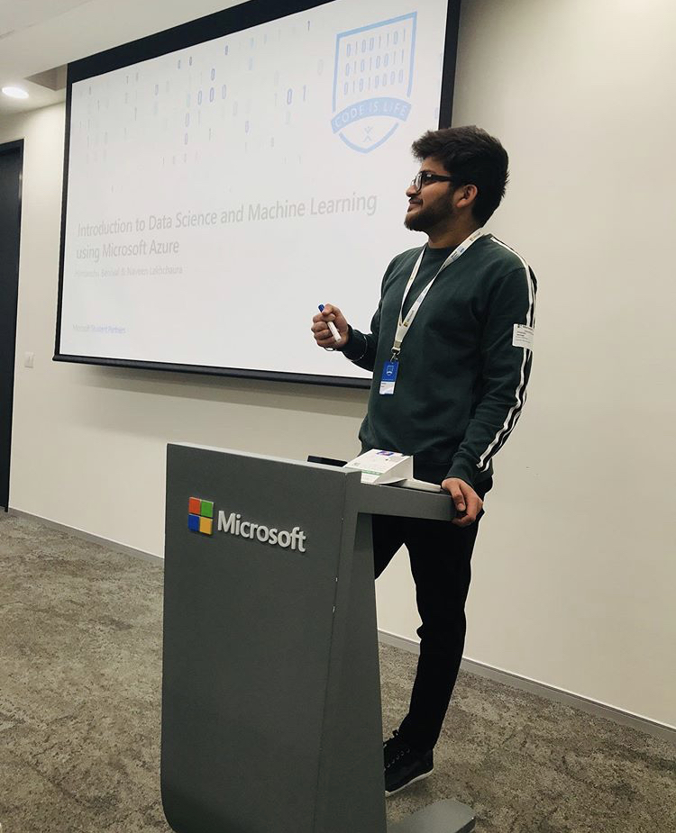


Hello! I’m Himanshu Beniwal! 👨🏻‍💻
Microsoft Student Partner since 2018.
M. Tech. in Computer Science, Central University of Punjab.
Self-driving cars, ML, Computer Vision, and much more.
🖤 to explore Azure ML & AI!
himanshubeniwal.codes
@HimanshuBeniwa

Slide 4

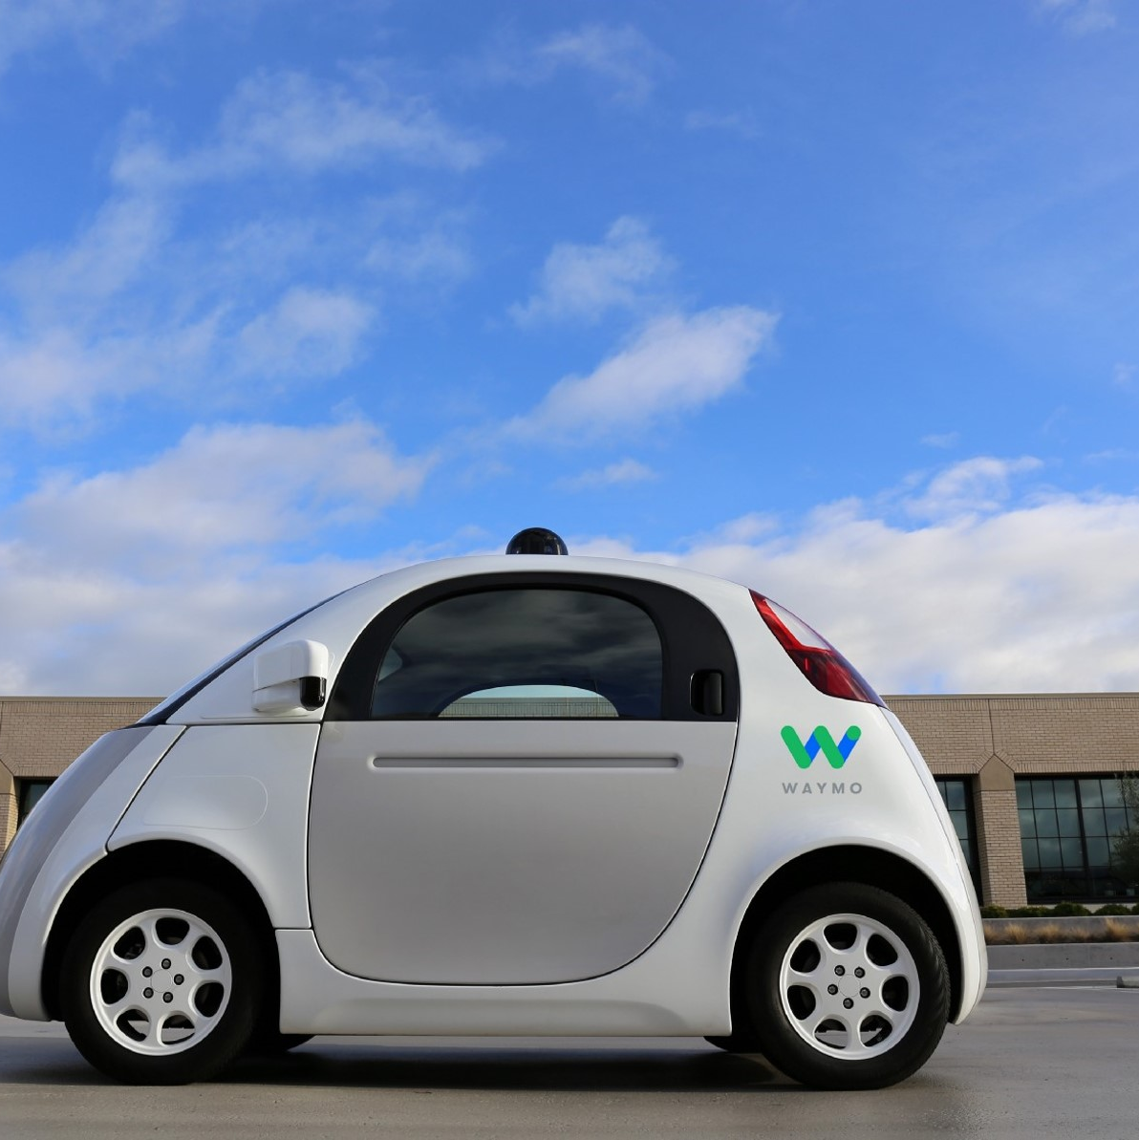
So where can you see AI?
…powered by
Machine Learning!
Artificial Intelligence or AI! 🐱‍💻
💻👨‍🔬
Self-driving cars!
Voice assistants
Healthcare
Predicting values (ML or DL)
And so much cool areas..
“It is a branch of Artificial Intelligence based on the idea that systems can learn from data, identify patterns and make decisions with minimal human intervention.” - Machine Learning is all about!

Slide 5
So where can you see AI? 🤖
Self-driving cars! 🚗
Voice assistants! 🎙
Healthcare! 👨‍⚕️
Predicting values (ML or DL) 🔮
And so much cool areas.. 🎮

Slide 6
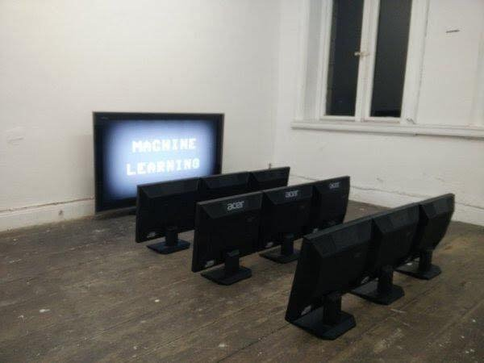
So, What is really Machine Learning?

Slide 7
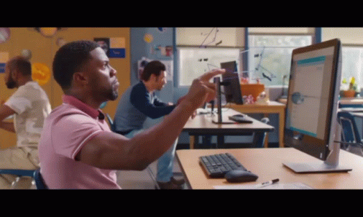
Is really Maths & Stats behind ML? 🤔

Slide 8


This is ML!
Build
Choose & configure your model
Clean
data
Filter
data
Train
Use your training dataset to build the model
Test
Use your test dataset to validate the model
Predict
If the model is good enough, use it!

Slide 9
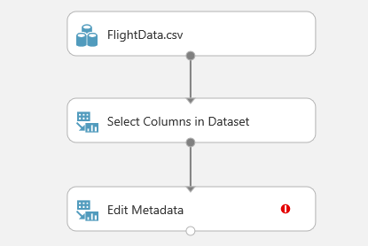
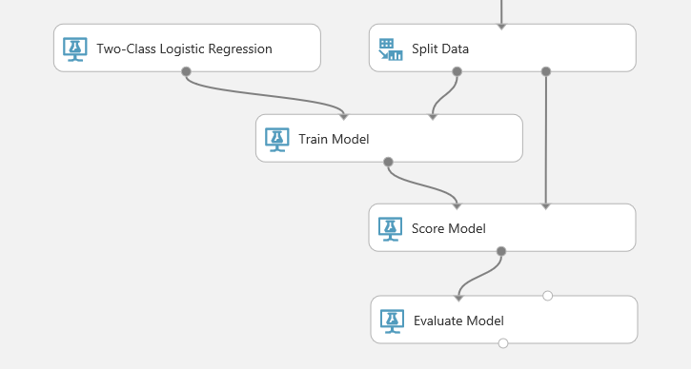
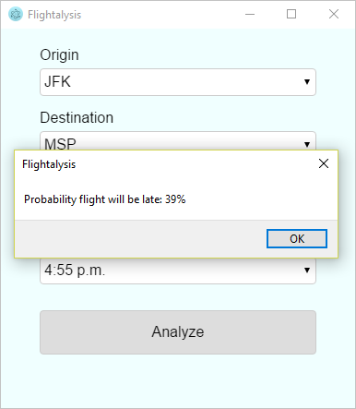
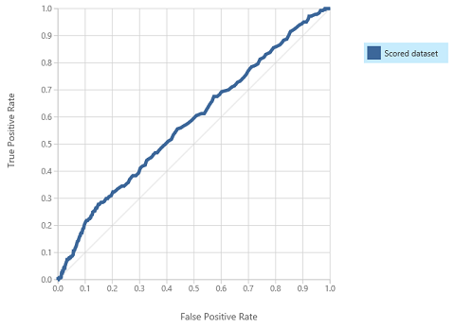
Predicting on-time flight arrivals with Azure ML Studio
1. Select Dataset
2. Build Model
4. Deploy!
3. Evaluate
Notes:
//demo is currently at: https://github.com/Microsoft/computerscience/tree/master/Events/Event-In-Box/Machine%20Learning%20Challenge
//we suggest you pull this into your own Azure ML Studio to show the model running. Set-up takes about 20 mins prior to this presentation.
Azure Machine Learning Studio is a cloud-based predictive-analytics service that offers a streamlined experience for data scientists of all skill levels. It features an easy to use, drag-and-drop interface for building machine-learning models. It comes with a library of time-saving experiments and features best-in-class algorithms developed and tested in the real world by Microsoft businesses such as Bing. And its built-in support for R and Python means you can build custom scripts to customize your model. Once you've built and trained your model, you can easily expose it as a Web service that is consumable from a variety of programming languages.
//Step through the building of a flight-tracking model here: https://github.com/Microsoft/computerscience/blob/master/Events/Event-In-Box/Machine%20Learning%20Challenge/Machine%20Learning%20Challenge.md

Slide 10

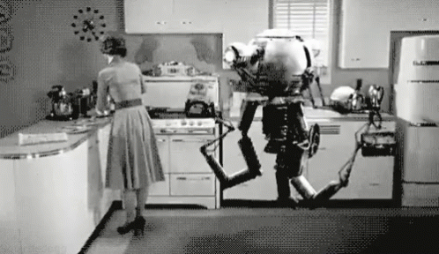
Applying ML to real-🌎!
Applying our ML model to the real-world in a more abstract way.
Understand the data concisely.
Gain expertise over more problem solving, like Kaggle or other competitive challenges.
Let’s just see further…

Slide 11

You can also use already trained models to do 🆒 stuff!

Slide 12
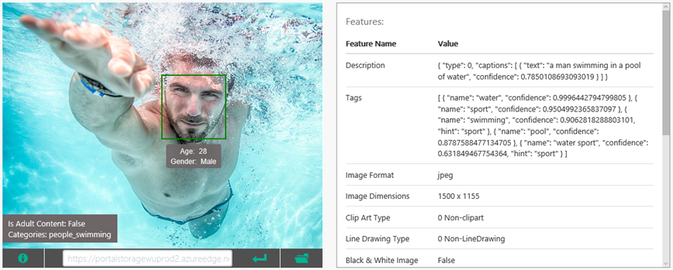
Use the Custom Vision API to analyze images for content, generate captions, and more ..

Slide 13
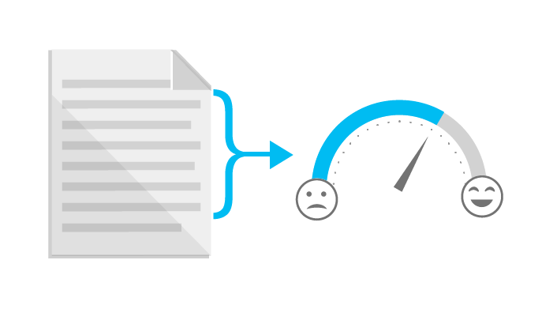
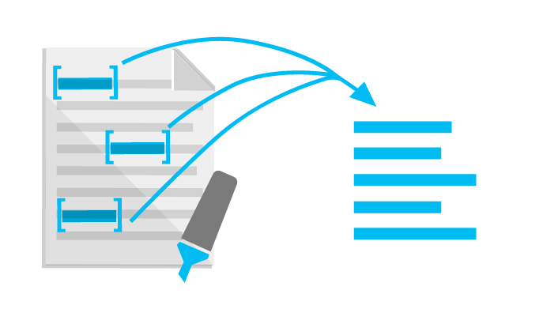
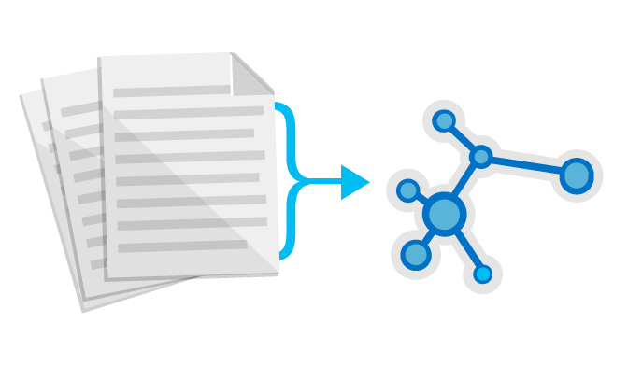
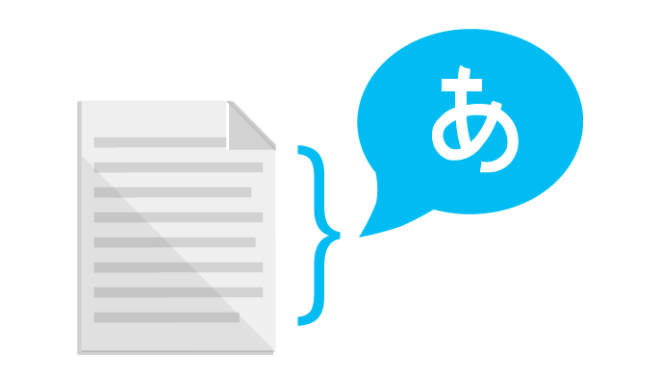
Use the Text Analytics API to identify sentiment expressed in text (e.g., Twitter feeds)
Sentiment Analysis
Key Phrase Extraction
Topic Detection
Language Detection

Slide 14
Demo: Azure cognitive services & Custom Vision! 😎
Himanshu Beniwal

Slide 15
Time to clean now! 🧹
Delete the resources which might hurt in background.
Save us from unexpected billing.
Keep an eye on the computing resources.

Slide 16
Wait! There’s some home-work for you!
Visit Microsoft Learn [https://docs.microsoft.com/en-us/learn/]
Basics of Data Science. [https://docs.microsoft.com/en-us/learn/modules/intro-to-data-science-in-azure/]
Learn about ML with Python and Azure Notebooks. [https://docs.microsoft.com/en-us/learn/paths/intro-to-ml-with-python/]
Publishing ML Experiment with Azure ML Studio. [https://docs.microsoft.com/en-us/learn/paths/publish-experiment-with-ml-studio/]
Classify images with Azure cognitive services. [https://docs.microsoft.com/en-us/learn/paths/classify-images-with-vision-services/]
Sneak from coding for Machine Learning using Azure [https://medium.com/@himanshubeniwal/sneak-from-coding-for-machinelearning-using-ms-azure-95e45c26ee3f]

Slide 17
And now finally!..

Slide 18




TYSM! 🐱‍💻 Connect with me on: @HimanshuBeniwa @himanshubeniwal @himanshubeniwal_

